Slide 1
LECTURE # 07
Software Construction and Development SE-312
Code Salvaging and Configuration Management
Course Instructor: Engr. Ruqqiya Asad
‹#›
Notes:
‹#›

Slide 2
Code Salvaging
Code Salvaging is the process of:
Reusing useful parts of existing code from old or legacy software in new software projects instead of writing everything from scratch.
It is a software maintenance technique to save time, cost, and effort.
‹#›

Slide 3
Objectives / Purpose
Save Time: Avoid rewriting modules that already work.
Reduce Cost: Less development and testing required.
Reuse Tested Code: Modules that were already tested can reduce errors.
Accelerate Development: Faster delivery of new system
‹#›

Slide 4
Types of Code Salvaging
Complete Module Salvage: Entire module reused without change.
Example: Tax calculation module from old billing system.
Partial Salvage: Some functions or classes reused.
Example: Authentication logic reused but with new UI.
Code Refactoring: Old code is modified for new system but logic remains.
Example: Legacy payroll logic adapted to new HR system.
‹#›
Notes:
‹#›

Slide 5
When is Code Salvaging Useful?
Legacy system modernization
System migration (e.g., desktop → web)
Upgrading software without losing working features
Large projects where rewriting is expensive
‹#›

Slide 6
Challenges in Code Salvaging
Poor Documentation: Old code may lack comments.
Compatibility Issues: Old code may not work in new language or framework.
Tightly Coupled Code: Hard to extract specific modules.
Hidden Bugs: Old code may have undetected issues.
‹#›

Slide 7
Example Scenario
Situation: A bank has a 15-year-old desktop software. Goal: Develop a mobile app.
Salvaged code: Transaction validation & security module
Rewritten: User interface, reports, and mobile-specific features
This avoids rewriting complex logic like transaction security from scratch.
‹#›

Slide 8
Steps in Code Salvaging
Identify modules to salvage – analyze old system to find reusable parts.
Check compatibility – ensure module fits in new system architecture.
Refactor if necessary – modify code to meet new requirements.
Integrate into new system – test salvaged modules with new code.
Document changes – record what is reused and what is modified.
‹#›

Slide 9
Configuration Management (CM)
Configuration Management is:
The process of systematically managing software versions, changes, and documentation to ensure controlled development and maintenance.
It ensures organized evolution of software, especially in multi-developer environments.
‹#›

Slide 10
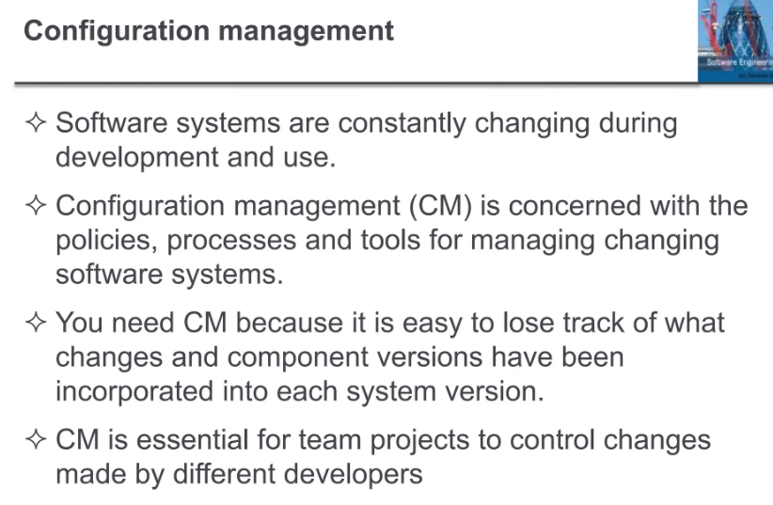

Slide 11
Objectives
Track changes – every modification is recorded.
Maintain versions – rollback if a change causes errors.
Coordinate team development – multiple developers can work without conflict.
Ensure stability – prevent accidental overwriting of working code.
Improve documentation – all changes are traceable.
‹#›

Slide 12
Key Activities of Configuration Management
2.3.1 Version Control
Track history of changes in code, documents, and configuration files.
Rollback to previous versions if needed.
Tools: Git, SVN
Example: Version 1.0 → Initial system Version 1.1 → Bug fixes Version 2.0 → Major feature update
‹#›

Slide 13
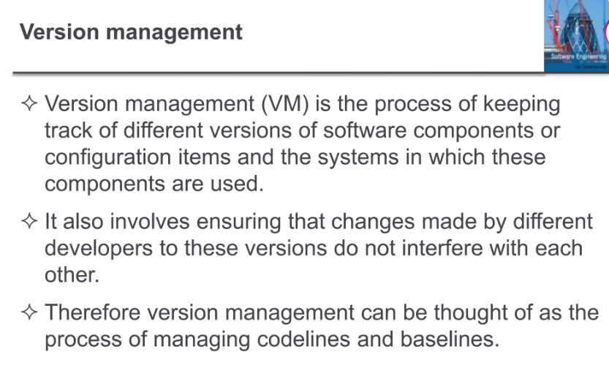

Slide 14
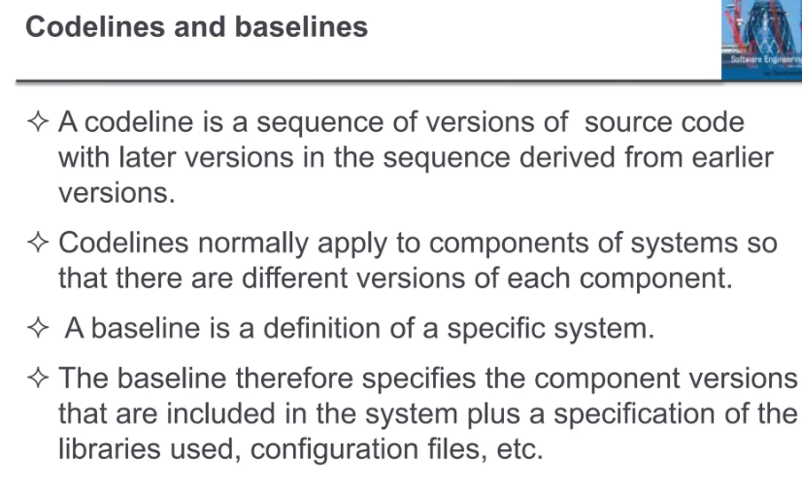

Slide 15
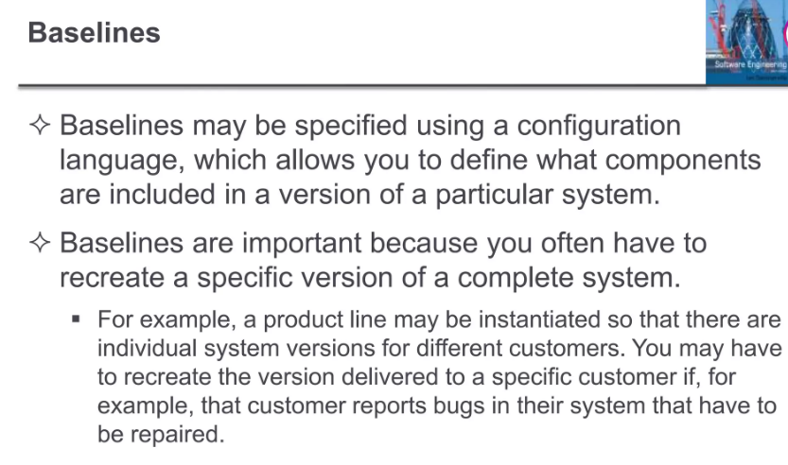

Slide 16
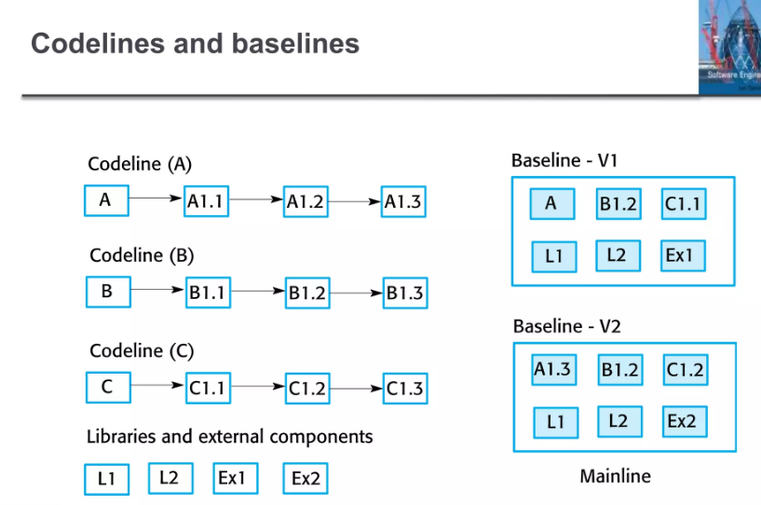

Slide 17
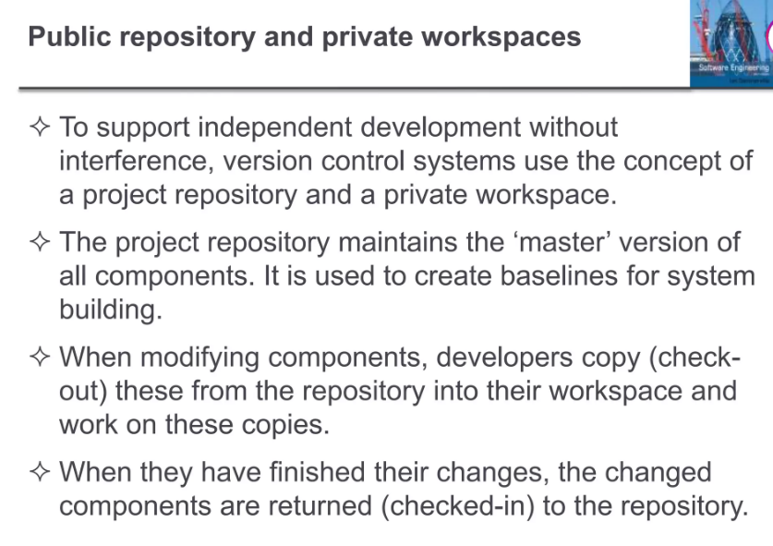

Slide 18
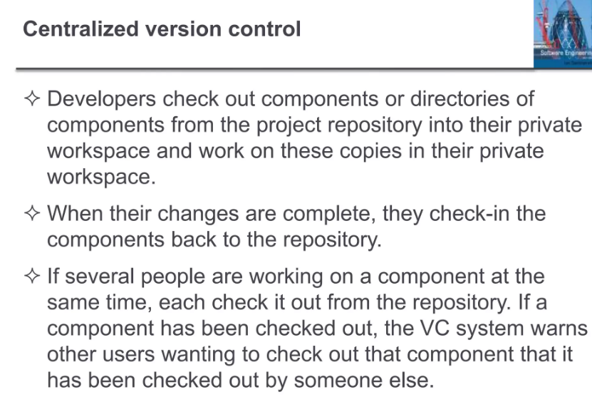

Slide 19
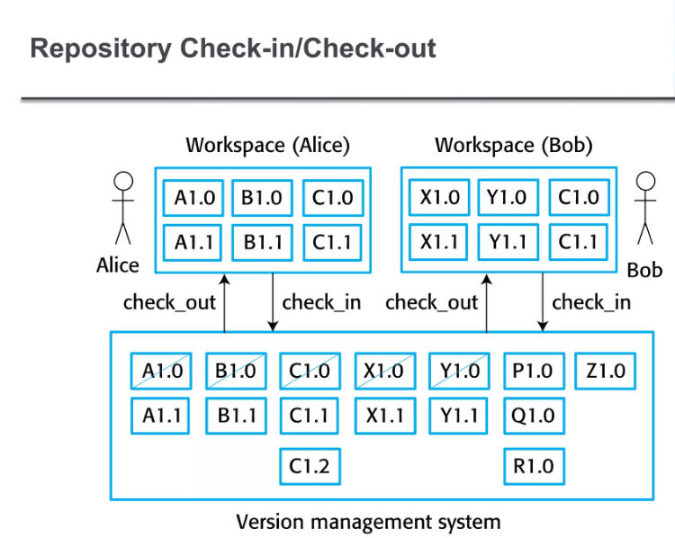

Slide 20
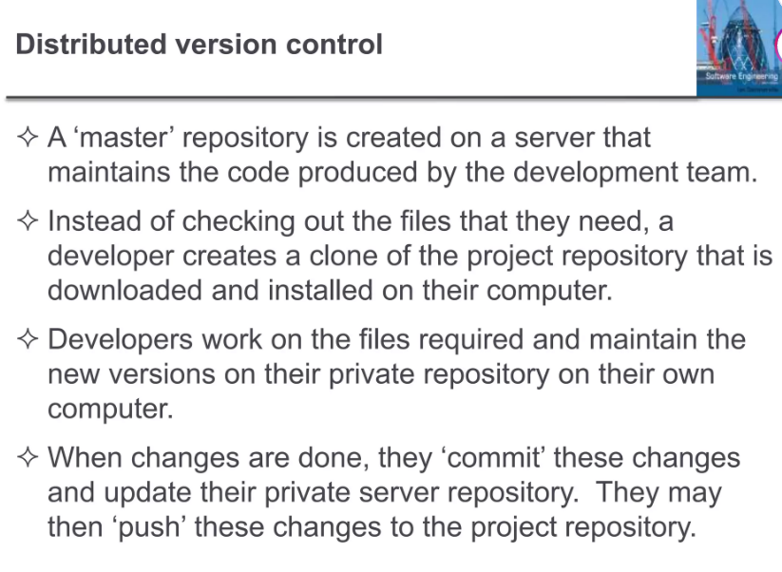

Slide 21
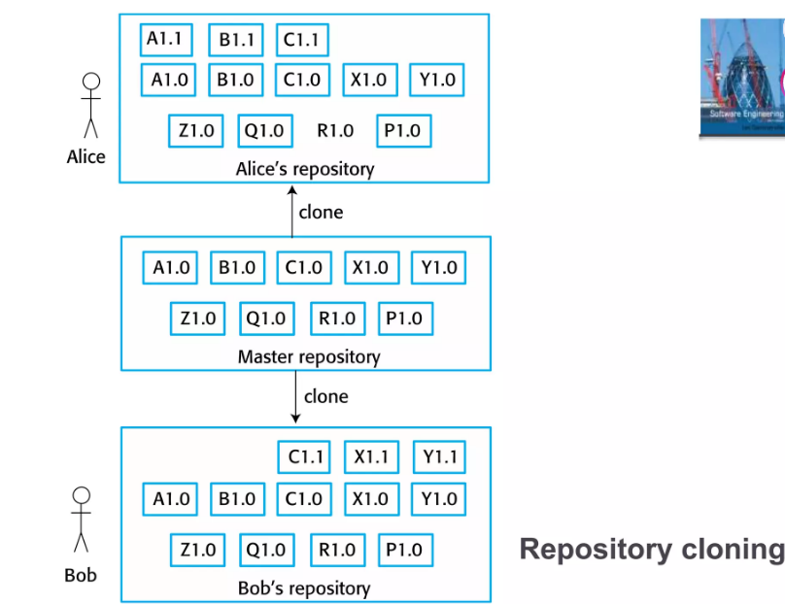

Slide 22
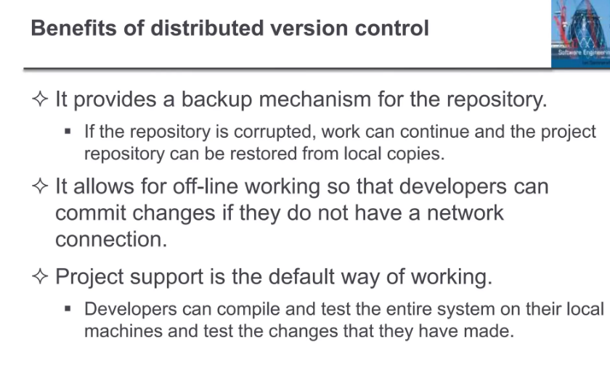

Slide 23
Change Control
All changes must be planned, approved, and documented.
Example: A developer cannot directly change production code. Steps:
Submit change request
Manager approves
Merge into main branch
‹#›

Slide 24
Build Management
Compiling and packaging software for testing or deployment.
Example:
Daily build of web application
Mobile APK generation
Executable for Windows desktop
‹#›

Slide 25
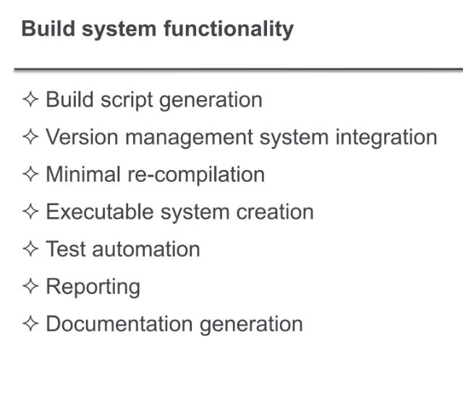

Slide 26
Release Management
Deploying software versions to end-users.
Example:
Release 1.0 → basic functionality
Release 1.1 → bug fixes
Release 2.0 → new features
‹#›

Slide 27
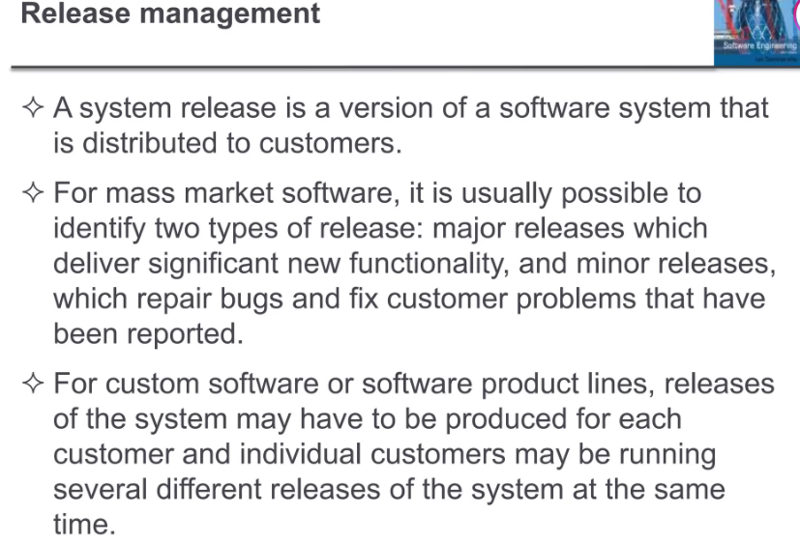

Slide 28
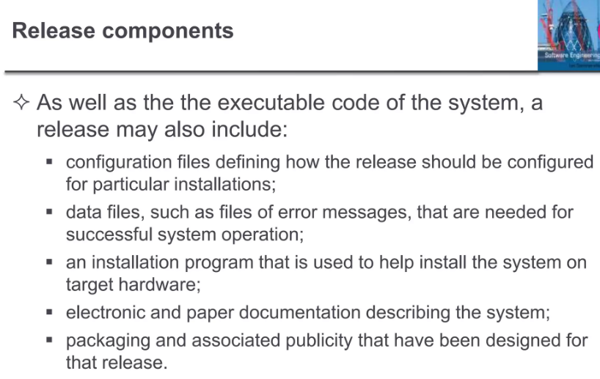

Slide 29
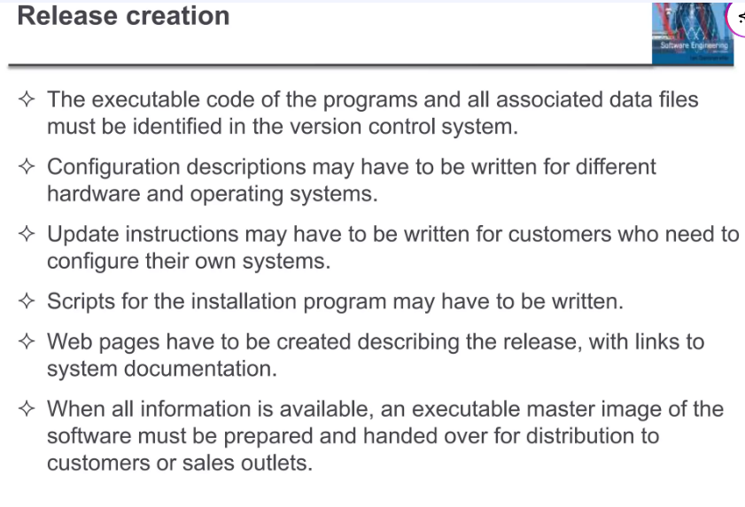

Slide 30
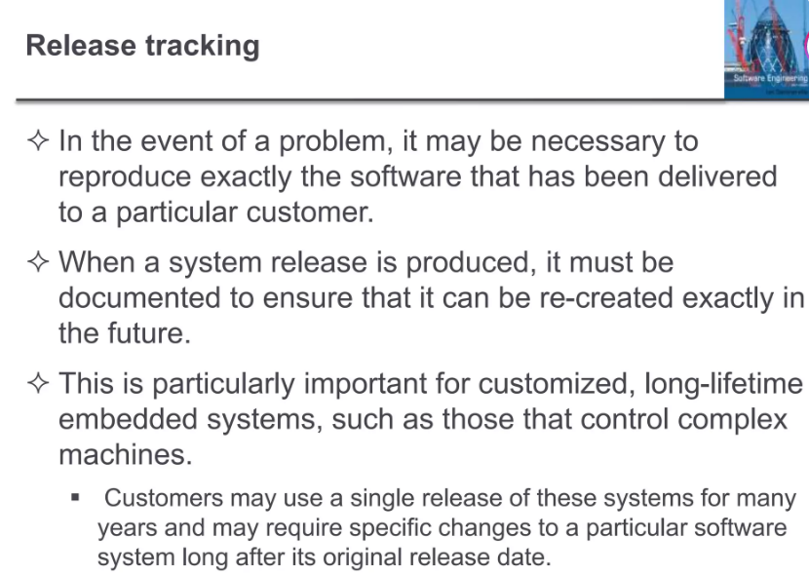

Slide 31
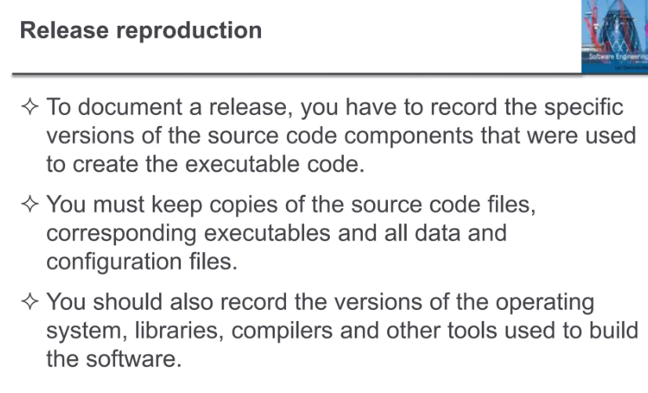

Slide 32
